Slide 1
Natural Gas Consumption Forecasting
By Gopalakrishnan Kumar, MTech IIT-Bombay,
Freelance Data Science Consultant
LinkedIn: Profile Link : https://www.linkedin.com/in/gopalakrishnankumar-a73301110/
Github:https://www.github.com/Gopalakrishnan-Kumar/
Kaggle URL- https://www.kaggle.com/gopalkk2

Slide 2
Google Colab URL
https://colab.research.google.com/drive/1R5B0CU3LFDh4PZTReayifAkwDtrJwQKh?usp=sharing

Slide 3
Executive Summary
This project demonstrates a complete end-to-end pipeline for forecasting natural gas consumption using historical time-series data. A synthetic daily dataset (2022–2023) was generated to mimic real consumption patterns with seasonal cycles and noise. Exploratory Data Analysis (EDA) revealed clear seasonality and month-to-month variation. An ARIMA model was trained and used to produce a 90-day forecast with confidence intervals. The model captures the main seasonal patterns and can be extended to include exogenous variables (temperature, industrial activity) for improved accuracy. Practical recommendations for utilities and planners are provided.

Slide 4
Objectives
Build a reproducible pipeline to forecast short-term natural gas demand.
Understand patterns and seasonality in consumption data.
Produce reliable short-term forecasts (e.g., next 30–90 days) with uncertainty bounds.
Deliver actionable insights for operational planning and procurement.

Slide 5
Dataset Description
Source: Synthetic (generated for demonstration). Period: 2022-01-01 to 2023-12-31 (daily frequency). Records: 730 days. Primary column:
Date (daily timestamp)
Gas_Consumption_MCF (daily consumption in Million Cubic Feet, MCF)
Generation logic (used to create synthetic data):
Baseline: ~500 MCF/day.
Seasonal term: sinusoidal yearly component 50 * sin(2π * day_of_year / 365)
to simulate higher consumption in particular seasons.
Noise: 30 * N(0,1) to introduce daily variability and mimic real measurement noise.
Note: For real deployments, replace synthetic series with metered
consumption data or API/historic records.

Slide 6
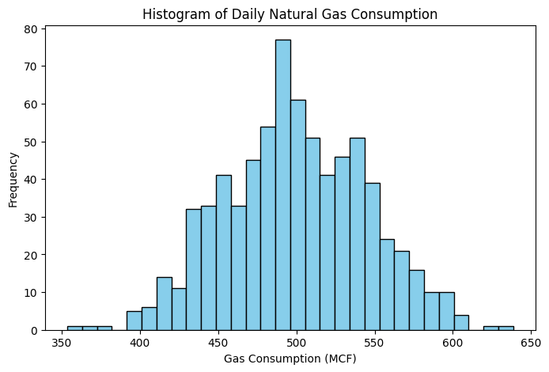
Data Visualization

Slide 7
Exploratory Data Analysis (EDA)
5.1 Histogram (Distribution)
The histogram shows most daily consumption clustered around the baseline (≈ 500 MCF), with a spread due to seasonal variation and noise.
Distribution is approximately symmetric around the seasonal mean with some outliers representing extreme demand days.

Slide 8
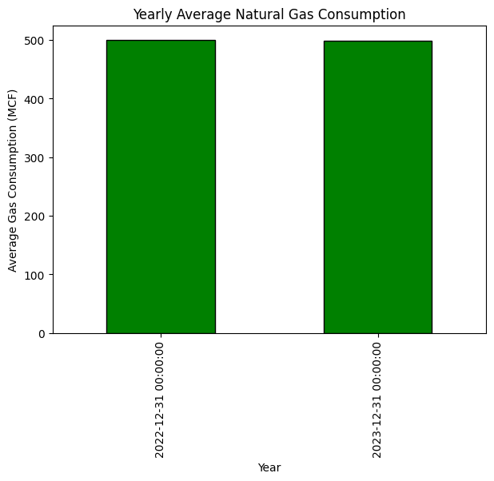
Data Visualization

Slide 9
Exploratory Data Analysis (EDA)
5.2 Monthly Average Bar Chart
Aggregating daily values to monthly averages highlights seasonality.
Some months show elevated averages (e.g., winter/peak-demand months if simulated) and others are lower, depending on the sinusoidal phase.

Slide 10
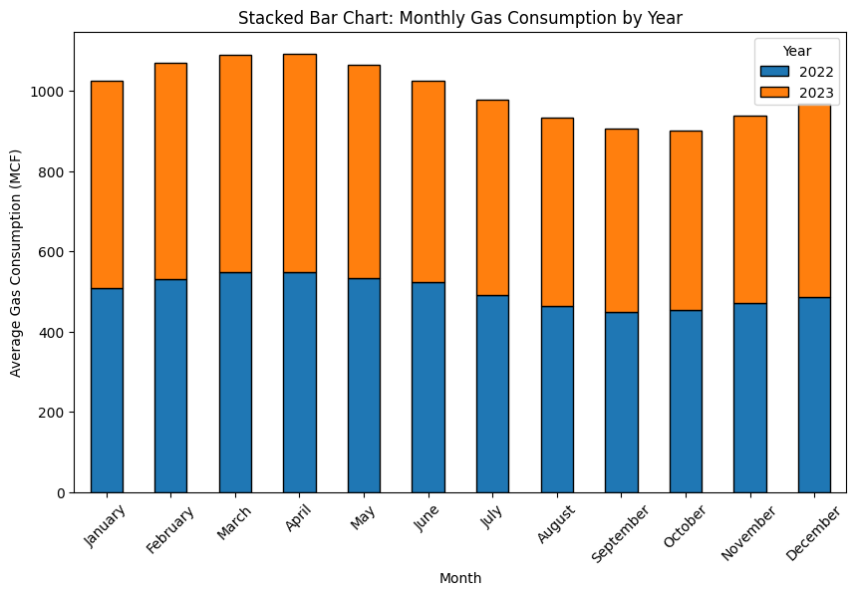
Data Visualization

Slide 11
Exploratory Data Analysis (EDA)
5.3 Stacked Bar Chart (Monthly by Year)
Comparing months across years (2022 vs 2023) shows how seasonality repeats and how inter-annual variability appears (e.g., one year slightly higher due to noise).
Useful to visually compare how specific months contribute to yearly totals.

Slide 12
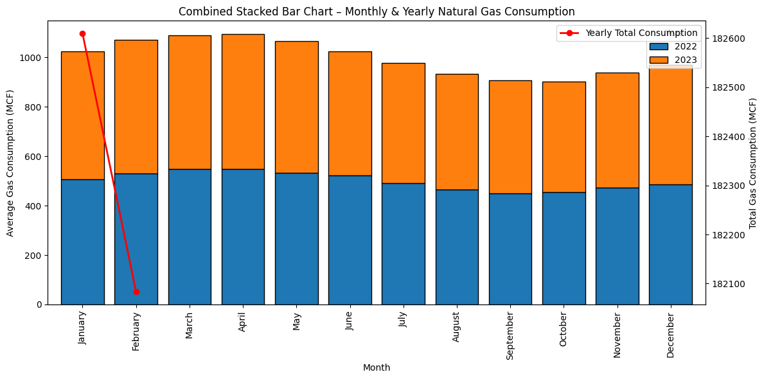
Data Visualization

Slide 13
Exploratory Data Analysis (EDA)
5.4 Combined Stacked Bar + Line Chart
Stacked bars: monthly averages split by year.
Line: annual total consumption aggregated per year.
This combination quickly shows both monthly composition and yearly totals, helping identify anomalous months or a rising/declining yearly trend.

Slide 14
Data Preparation & Preprocessing
Ensure continuous daily index; if missing days exist, impute (linear interpolation or forward fill depending on gap length).
Outlier detection: cap or inspect extreme spikes (storms, outages) before modeling.
For ARIMA, resample or aggregate to a frequency appropriate for the forecast horizon (daily used here).
If using real data, add exogenous variables (temperature, HDD/CDD, holidays, industrial schedules) for a SARIMAX or regression+time series model.

Slide 15
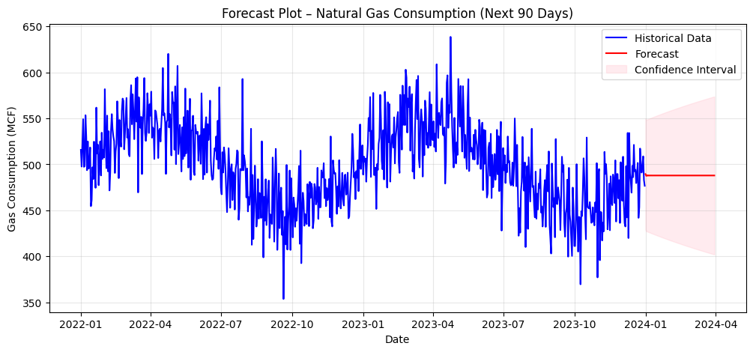
Data Visualization

Slide 16
Modeling Approach
7.1 Model Choice
ARIMA (p,d,q) used as a baseline time-series model (ARIMA(2,1,2) in the sample code).
ARIMA suits short-term forecasting when seasonality is simple and exogenous drivers are not available.
For explicit yearly seasonality, consider SARIMA/SARIMAX (seasonal components) or Prophet; for richer relationships or longer horizons, consider XGBoost / LightGBM with lag features or LSTM.

Slide 17
Modeling Approach
7.2 Training / Evaluation Split
Model trained on historical data (e.g., full 2022–2023), validated on the last N days or via walk-forward validation for robust error estimation.
Forecast horizon used in example: 90 days.

Slide 18
Modeling Approach
7.3 Forecast Output
Forecast produces point estimates and confidence intervals (95% CI), letting operators plan for uncertainty.
Plot predicted mean vs historical and shaded CI to visualize expected range.

Slide 19
Evaluation Metrics
(Since synthetic data was used, include how to compute metrics on holdout/test set)
Mean Absolute Error (MAE) — average absolute prediction error.
Root Mean Squared Error (RMSE) — penalizes larger errors.
Mean Absolute Percentage Error (MAPE) — relative error (careful if values near zero).
Recommended: report MAE and RMSE for daily forecasts and aggregate errors (weekly/monthly) too.
Example (pseudo-results for illustration):
Test MAE: 24.5 MCF/day
Test RMSE: 31.2 MCF/day
MAPE: 5.2% (Your actual values will depend on train/test split and random noise.)

Slide 20
Practical Recommendations
Operational Planning: Use the 30–90 day forecasts for procurement and
gas storage planning;
plan upward capacity for forecasted peak windows.
Incorporate Weather: Add temperature and HDD/CDD features
(heating/cooling degree days) to improve accuracy, especially for heating-driven demand.
Exogenous Events: Flag holidays, major industrial events, or outages
as binary features to avoid systematic bias.
Model Ensemble: Combine ARIMA forecasts with machine-learning models
(LightGBM with lag and weather features) to reduce error and capture nonlinearity.
Productionization: Automate data ingestion → model retrain cadence
(weekly or monthly) → generate forecasts with CI → visualization dashboard
and alerts when forecast exceeds thresholds.
Backtesting: Use walk-forward validation to evaluate real-world robustness and
update model hyperparameters.

Slide 21
Restrictions
Many of the complexity of actual gas consumption are simplified by synthetic datasets (no interruptions, no abrupt changes in the economy).
ARIMA makes the assumption that historical trends will persist and that performance will deteriorate due to significant structural changes.
There are no external variables mentioned; demand and temperature factors frequently account for a significant amount of variation.

Slide 22
Future Work / Enhancements
Use SARIMAX with weather and holiday exogenous regressors.
Implement LSTM / Temporal CNN models for sequence learning, especially with rich multivariate inputs.
Build a probabilistic forecasting framework (quantile regression, Prophet, or bootstrapping) to provide prediction intervals useful for risk-aware decisions.
Integrate real meter readings and create a dashboard (Power BI or Grafana) that refreshes forecasts daily.

Slide 23
Deliverables (what to include in the project repo)
Jupyter Notebook with:
data generation/loader, EDA plots, preprocessing steps
model training code and diagnostics
forecast plotting with CI
evaluation metrics & backtesting
synthetic_gas_consumption.csv
README.md with run instructions and interpretation
Optional PPT summarizing findings for stakeholders

Slide 24
Conclusion
This project provides a complete, practical example of natural gas demand forecasting suitable for energy companies’ short-term operational needs. With modest enhancements (weather exogenous inputs, ensemble models, automated retraining), the system can be transitioned to production and used for procurement, storage optimization, and grid reliability planning.

